Slide 1

Note: The data and information in this document is reflective of a hypothetical situation and client. This document is to be used for KPMG Virtual Internship purposes only.
Sprocket Central Pty Ltd
Data analytics approach
[Division Name] - [Engagement Manager], [Senior Consultant], [Junior Consultant]

Slide 2
Note: The data and information in this document is reflective of a hypothetical situation and client. This document is to be used for KPMG Virtual Internship purposes only.
Agenda
Introduction
Data Exploration
Model Development
Interpretation

Slide 3
Note: The data and information in this document is reflective of a hypothetical situation and client. This document is to be used for KPMG Virtual Internship purposes only.
Introduction
EXTENSIVE ANALYSIS FOR TARGETING 1000 NEW CUSTOMERS
1.AGE AS A CONTINUOUS VARIABLE
2.TENURE OF CUSTOMERS
3.OWNERSHIP OF CARS
4.WEALTH SEGMENT
5.RECORD PAST 3 YEARS BIKE RELATED PURCHASES

Slide 4
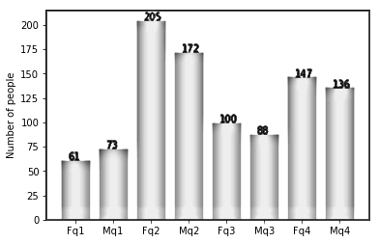
Note: The data and information in this document is reflective of a hypothetical situation and client. This document is to be used for KPMG Virtual Internship purposes only.
Data Exploration
AGE DISTRIBUITION
AS WE CAN INFER FROM THE GRAPH THAT THE NEW CUSTOMERS ARE IN THE RANGE 25-50 YEARS OF AGE.
THERE IS SUDDEN INCREASE IN FEMALE CUSTOMERS ABOVE 25 YEARS.
NUMBER OF MALES AND FEMALES OVER 60 ARE SOMEWHAT EQUAL.
SO AGE PLAYS A CONTINUOUS VARIABLE.
q1: Under 25; q2: 25 to 50; q3: 50 to 60; q4: Over 60.M=MALE,F=FEMALE.

Slide 5
Note: The data and information in this document is reflective of a hypothetical situation and client. This document is to be used for KPMG Virtual Internship purposes only.
Model Development
CUSTOMER’S TENURE AS A TOOL FOR DEVELOPING MODEL
AS WE CAN INFER FROM THE GRAPH THE PROBABILITY OF OWNING A CAR IN A GIVEN TENURE IS BELOW 20.
THAT WAY WE OBSERVE 20 OUT OF 1000 CUSTOMERS IN A GIVEN TENURE HAVE A CAR.
.
YES AND NO DENOTE OWNER SHIP OF CARS WRT TO TENURE OF CUSTOMERS.

Slide 6
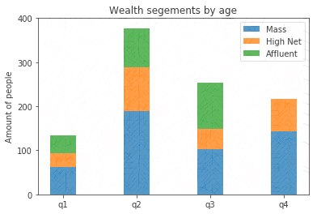
Note: The data and information in this document is reflective of a hypothetical situation and client. This document is to be used for KPMG Virtual Internship purposes only.
Model Development
WEALTH SEGMENTS
AS WE CAN INFER FROM THE GRAPH AMOUNT OF PEOPLE IN CATEGORY OF MASS CUSTOMERS OCCUPIES THE TOP NOTCH OF WEALTH SEGMENTS.
NEXT ON THE SCALE ARE HIGH NET CUSTOMERS AND FOLLOWING ARE THE AFFLUENT CUSTOMERS AS IN THE FOCUS FOR THE 2 SUBCLASSES SHOULD BE IN QUADRANT q2 AND q3.
SO WEALTH PLAYS A IMP. ROLE TO INCREASE THE SALES.

Slide 7
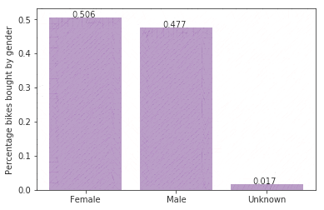
Interpretation
PAST 3 YEARS BIKE RELATED PURCHASES
AS WE CAN INFER FROM THE GRAPH THAT ABOUT 50.6% OF THE CUSTOMERS WHO BOUGHT BIKES IN THE PAST 3 YEARS PURCHASE RECORD TURN OUT TO BE FEMALE.
ON THE OTHER HAND ,MALES ARE JUST BELOW FEMALES WITH 47.7% BIKE BUYERS.
SO TO INCREASE OUR SALES WE MUST FOCUS MORE ON FEMALE CUSTOMERS.

Slide 8
Note: The data and information in this document is reflective of a hypothetical situation and client. This document is to be used for KPMG Virtual Internship purposes only.
Appendix

